Slide 1
Dynamic Programming
Algorithm : Design & Analysis
[16]

Slide 2
In the last class…
Shortest Path and Transitive Closure
Washall’s Algorithm for Transitive Closure
All-Pair Shortest Paths
Matrix for Transitive Closure
Multiplying Bit Matrices - Kronrod’s Algorithm

Slide 3
Dynamic Programming
Recursion and Subproblem Graph
Basic Idea of Dynamic Programming
Least Cost of Matrix Multiplication
Extracting Optimal Multiplication Order

Slide 4
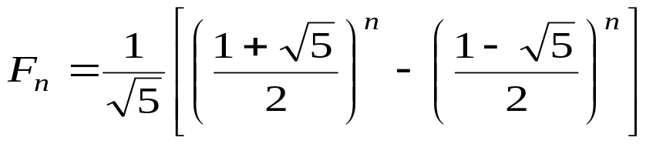
Natural Recursion may be Expensive
1
6
The F_{n} can be computed in linear time easily, but the cost for recursion may be exponential.
2
17
5
4
3
12
18
23
4
3
3
2
4
9
13
16
19
22
3
2
2
1
2
1
1
0
The number of activation frames are 2F_{n+1}-1
24
25
5
8
15
20
21
2
1
1
0
1
0
1
0
10
11
14
6
7
1
0
Fibonacci: F_{n}= F_{n-1}+F_{n-2}
For your reference
1, 1, 2, 3, 5, 8, 13, 21, 35, ...

Slide 5
Subproblem Graph
For any known recursive algorithm A for a specific problem, a subproblem graph is defined as:
  vertex: the instance of the problem
  directed edge: the subproblem graph contains a directed edge I→J if and only if when A invoked on I, it makes a recursive call directly on instance J.
Portion A(P) of the subproblem graph for Fibonacci function: here is fib(6)
6
5
4
3
2
1
0

Slide 6
Properties of Subproblem Graph
If A always terminates, the subproblem graph for A is a DAG.
For each path in the tree of activation frames of a particular call of A, A(P), there is a corresponding path in the subproblem graph of A connecting vertex P and a base-case vertex.
A top-level recursive computation traverse the entire subproblem graph in some memoryless style.
The subproblem graph can be viewed as a dependency graph of subtasks to be solved.

Slide 7
Basic Idea for Dynamic Programming
Computing each subproblem only once
  Find a reverse topological order for the subproblem graph
    In most cases, the order can be determined by particular knowledge of the problem.
    General method based on DFS is available
  Scheduling the subproblems according to the reverse topological order
  Record the subproblem solutions for later use

Slide 8
Dynamic Programming Version DP(A) of a Recursive Algorithm A
Case 1: White Q
Case 2: Black Q
a instance, Q, to be called on
a instance, Q, to be called on
To backtracking, record the result into the dictionary (Q, turned black)
Q
Q
Q is finished (black), only “checking” the edge, retrieve the result from the dictionary
Q is undiscovered (white), go ahead with the recursive call
Note: for DAG, no gray vertex will be met

Slide 9
DP(fib): an Example
fibDP(soln,k)
int fib, f1, f2;
if (k<2) fib=k;
else
if (member(soln, k-1)==false)
f1=fibDP(soln, k-1);
else
f1= retrieve(soln, k-1);
if (member(soln, k-2)==false)
f2=fibDP(soln, k-2);
else
f2= retrieve(soln, k-2);
fib=f1+f2;
store(soln, k, fib);
return fib
fibDPwrap(n)
Dict soln=create(n);
return fibDP(soln,n)
This is the wrapper, which will contain processing existing in original recursive algorithm wrapper.

Slide 10
Matrix Multiplication Order Problem
The task:
Find the product: A₁×A₂×…×A_{n-1}×A_{n}
A_{i} is 2-dimentional array of different legal size
The issues:
  Matrix multiplication is associative
  Different computing order results in great difference in the number of operations
The problem:
  Which is the best computing order

Slide 11

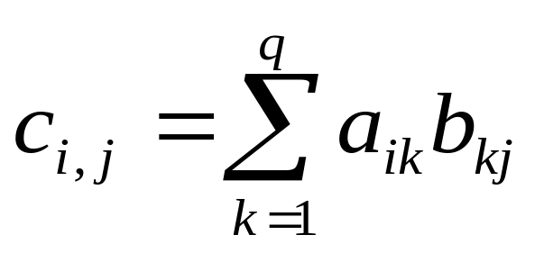
Cost of Matrix Multiplication
An example: A₁ × A₂ × A₃ × A₄
30×1 1×40 40×10 10×25
((A₁×A₂)×A₃)×A₄: 20700 multiplications
A₁×(A₂×(A₃×A₄)): 11750
(A₁×A₂)×(A₃×A₄): 41200
A₁×((A₂×A₃)×A₄): 1400
Let C = A_{p×q}×B_{q×r}
There are q multiplication
C has p×r elements as c_{i,j}
So, pqr multiplications altogether

Slide 12
Looking for a Greedy Solution
Greedy algorithms are usually simple.
Strategy 1: “cheapest multiplication first”
  Success: A_{30×1}×((A_{1×40}× A_{40×10})×A_{10×25}
  Fail: (A_{4×1}×A_{1×100})×A_{100×5}
Strategy 2: “largest dimension first”
  Correct for the second example above
  A_{1×10}×A_{10×10}×A_{10×2}: two results

Slide 13
Problem and Sub-problem: Intuition
Matrices: A₁, A₂, …, A_{n}
Dimension: dim: d₀, d₁, d₂, …, d_{n-1}, d_{n}, for A_{i} is d_{i-1}×d_{i}
Sub-problem: seq: s₀, s₁, s₂, …, s_{k-1}, s_{len}, which means the multiplication of k matrices, with the dimensions: d_{s0}×d_{s1}, d_{s1}×d_{s2}, …, d_{s[len]-1}×d_{s[len]} .
  Note: the original problem is: seq=(0,1,2,…,n)

Slide 14
Cost of the Optimum Order by Recursion
Recursion on index sequence:
(seq): 0, 1, 2, …, n (len=n)
with the kth matrix is A_{k} (k≠0) of the size d_{k-1}×d_{k} ,
and the kth(k<n) multiplication is A_{k}×A_{k+1}.
mmTry1(dim, len, seq)
if (len<3) bestCost=0
else
bestCost=∞;
for (i=1; i≤len-1; i++)
c=cost of multiplication at position seq[i];
newSeq=seq with ith element deleted;
b=mmTry1(Dim, len-1, newSeq);
bestCost=min(bestCost, b+c);
return bestCost
T(n)=(n-1)T(n-1)+n, in Θ((n-1)!)

Slide 15
Constructing the Subproblem Graph
The key issue is: how can a subproblem be denoted using a concise identifier?
For mmTry1, the difficult originates from the varied intervals in each newSeq.
If we look at the last (contrast to the first) multiplication, the two (not one) resulted subproblems are both contiguous subsequences, which can be uniquely determined by the pair:
<head-index, tail-index>

Slide 16
Best Order by Recursion: Improved
Only one matrix
mmTry2(dim, low, high)
if (high-low= =1) bestCost=0
else
bestCost=∞;
for (k=low+1; k≤high-1; k++)
a=mmTry2(dim, low, k);
b=mmTry2(dim, k, high);
c=cost of multiplication at position k;
bestCost=min(bestCost, a+b+c);
return bestCost
with dimensions: dim[low], dim[k], and dim[high]
Still in Ω(2^{n})!

Slide 17
Best Order by Dynamic Programming
DFS can traverse the subproblem graph in time O(n³)
  At most n²/2 vertices, as <i,j>, 0≤i<j≤n.
  At most 2n edges leaving a vertex
mmTry2DP(dim, low, high, cost)
……
for (k=low+1; k≤high-1; k++)
if (member(low,k)==false) a=mmTry2(dim, low, k);
else a=retrieve(cost, low, k);
if (member(k,high)==false) b=mmTry2(dim, k, high);
else b=retrieve(cost, k, high);
……
store(cost, low, high, bestCost);
return bestCost
Corresponding to the recursive procedure of DFS

Slide 18
Simplification Using Ordering Feature
matrixOrder(n, cost, last)
for (low=n-1; low≥1; low--)
for (high=low+1; high≤n; high++)
return cost[0][n]
Computing subproblems according the dependency order
Compute solution of subproblem (low, high) and store it in cost[low][high] and last[low][high]

Slide 19
Matrix Multiplication Order: Algorithm
float matrixOrder(int[] dim, int n, int[] multOrder)
<initialization of last,cost,bestcost,bestlast…>
for (low=n-1; low≥1; low--)
for (high=low+1; high≤n; high++)
if (high-low==1) <base case>
else bestcost=∞;
for (k=low+1; k≤high-1; k++)
a=cost[low][k];
b=cost[k][high]
c=multCost(dim[low], dim[k], dim[high]);
if (a+b+c<bestCost)
bestCost=a+b+c; bestLast=k;
cost[low][high]=bestCost;
last[low][high]=bestLast;
extrctOrderWrap(n, last, multOrder)
return cost[0][n]
Input: array dim =(d₀, d₁, …, d_{n}), the dimension of the matrices.
Output: array multOrder, of which the ith entry is the index of the ith multiplication in an optimum sequence.
Using the stored results

Slide 20
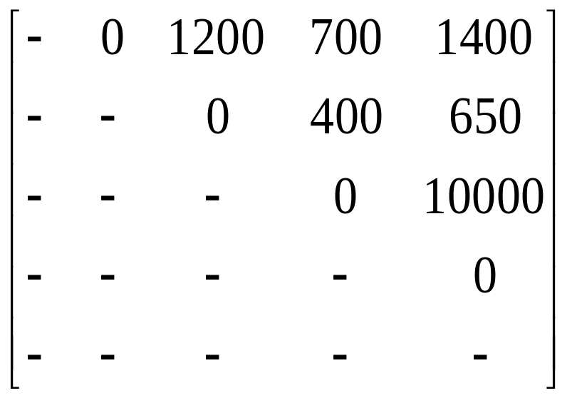
An Example
Input: d₀=30, d₁=1, d₂=40, d₃=10, d₄=25
cost as finished
Note: cost[i][j] is the least cost of A_{i+1}×A_{i+2}×…A_{j}.
For each selected k, retrieving:
least cost of A_{i+1}×…×A_{k}.
least cost of A_{k+1}×…×A_{j}.
and computing:
cost of the last multiplication
First entry filled
Last entry filled

Slide 21
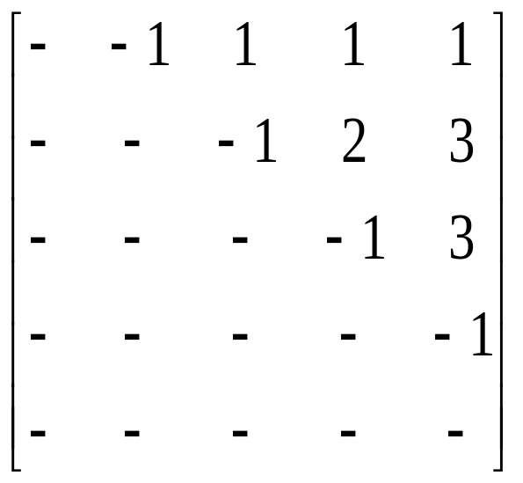
Array last and the Arithmetic-Expression Tree
Example input: d₀=30, d₁=1, d₂=40, d₃=10, d₄=25
last as finished
(0,4)
As root
×
(1,4)
×
A₁
(1,3)
(3,4)
(0,1)
×
A₄
Computing in post order
A₂
A₃
(1,2)
(2,3)

Slide 22

Extracting the Optimal Order
The core procedure is extractOrder, which fills the multiOrder array for subproblem (low,high), using informations in last array.
extractOrder(low, high, last, multOrder)
int k;
if (high-low>1)
k=last[low][high];
extractOrder(low, k, last, multOrder);
extractOrder(k, high, last, multOrder);
multOrder[multOrderNext]=k;
multOrderNext++;
Just a post-order traversal
initialized in the wrapper

Slide 23

Calling Map
Output, passed to extractOrder
float matrixOrder (int [ ] dim, int n, int [ ] multOrder )
int [ ] last; float [ ] cost; int low, high, ......
for (low=n-1; low≥1; low--)
for (high=low+1; high≤n; high++)
......
for (k=low+1; k≤high-1; k++)
<Computing all possible multCost by calling multCost>
<Filling the entries in cost and last (one entry for each)>
extractOrderWrap(n, last, multOrder)
return cost[0][n];
extractOrder(low, high, last, multOrder)
<Whenever high>low, call recursively on (low,k) and (k,high) where k=last[low][high]>

Slide 24
Analysis of matrixOrder
Main body: 3 layer of loops
  Time: the innermost processing costs constant, which is executed Θ(n³) times.
  Space: extra space for cost and last, both in Θ(n²)
Order extracting
  There are 2n-1 nodes in the arithmetic-expression tree. For each node, extractOrder is called once. Since non-recursive cost for extractOrder is constant, so, the complexity of extractOrder is in Θ(n)

Slide 25
Home Assignment
10.1
10.4
10.6
10.7

